Slide 1
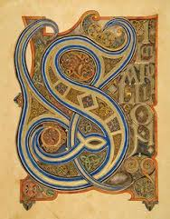
What do you observe in this painting?

Slide 2
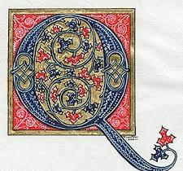
What is different about this font?

Slide 3
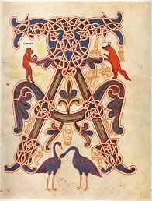
Do you notice symmetry?

Slide 4
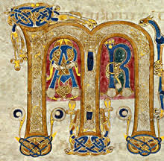
What else is hiding in this letter? Why?

Slide 5
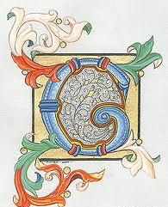
These are ILLUMINATED MANUSCRIPTS
Before books were printed, each one was hand written!

Slide 6
Lets design our own
ILLUMINATED MANUSCRIPT
1) Choose the first letter of your first or last name.
2) Brainstorm ways that you would like to fill the space with this one letter. Will it be a block or bubble letter? Will it be in cursive?
3) Explore ways to add imagery, shapes, colors and lines as added details to illustrate your identity through your values, hobbies and people and things that are important to you.
Here is a list identifiers that will help you think about what makes you YOU: AGE, GENDER, FAMILY STRUCTURE, RELIGION/FAITH, CULTURAL TRADITIONS, RACE, ETHNICITY, ABILITY

